Slide 1
To be sure, to be sure
2 Peter 1:16-2:3

Slide 2
The Bible as a battle ground
It is mis-translated
It is full of contradictions
Some have changed it
Some have added to it

Slide 3
‘we did not follow cleverly devised stories when we told you about the coming of our Lord Jesus Christ in power’.
The Reliability of God’s Word

Slide 4

How can we be sure that we have the truth about Jesus?
Peter gives us two reasons
His personal testimony
The word of the prophets

Slide 5
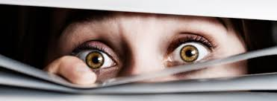
How can we be sure that we have the truth about Jesus?
His personal testimony
What they saw
with their eyes
What they heard with their ears

Slide 6
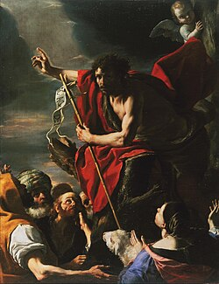
How can we be sure that we have the truth about Jesus?
The word of the
prophets
Prophetic message is completely reliable
Progressive revelation of God
False Prophets

Slide 7
How can we be sure that we have the truth about Jesus?
True prophecy never had its origin in the human will,
False Prophets
Zedekiah & Micaiah 2Chron18
Balaam and the talking ass
Modern day false prophets

Slide 8
we did not follow cleverly devised stories when we told you about the coming of our Lord Jesus Christ in power, but we were eyewitnesses of his majesty.
Holy words of our faith
Handed down to this age
Came to us through sacrifice
Oh, heed the faithful words of
Christ

